Slide 1

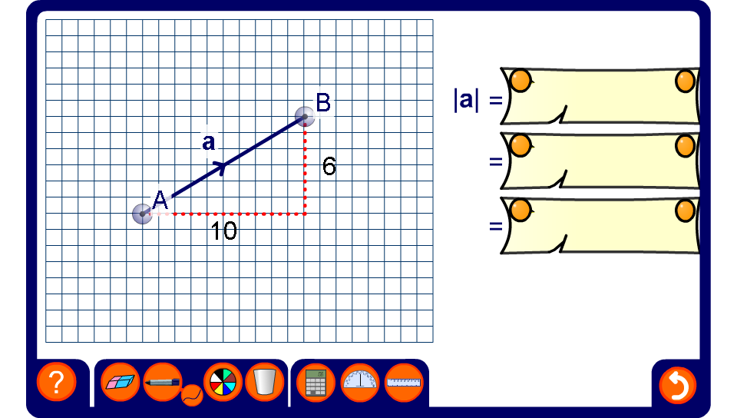


Finding the magnitude of a vector
Notes:
Use this activity to demonstrate finding the magnitude of a variety of vectors.

